Slide 1

Your logo here
Regional KPI Report - North America Presented by Gary Gruccio

Slide 2
Analyzing the Revenue Variance in North America
North America fell short of the revenue goal by -$43.69m (-32.39%)
All regions were below the goal, with North America having the largest variance
Further investigation is needed to identify the cause of this shortfall
Recommendation: Implement targeted strategies to boost sales in North America
Source: Alteryx Auto Insights
Notes:
This slide presents the variance in revenue for North America. It's noticeable that the region fell short of its goal, contributing to the overall shortfall across all regions. Further analysis is needed to pinpoint the causes, and to inform targeted strategies to increase sales.

Slide 3
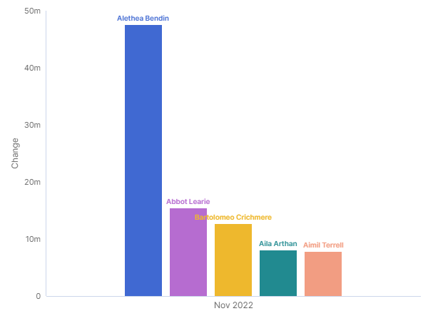
Account Manager's Contribution to Revenue Increase
New and returning Account Managers contributed to a $91.18m increase in revenue
All five Account Managers saw an increase in revenue
Alethea Bendin, Abbot Learie, Bartolomeo Crichmere, Aila Arthan and Aimil Terrell were the most significant contributors
Recommendation: Recognize and reward these Account Managers, and share their successful strategies across the team
Source: Alteryx Auto Insights
Notes:
This slide highlights the positive contribution of our Account Managers to the revenue increase. As we can see, new and returning Account Managers have significantly boosted the revenue. It would be beneficial to recognize their efforts and disseminate their successful strategies among the team.

Slide 4
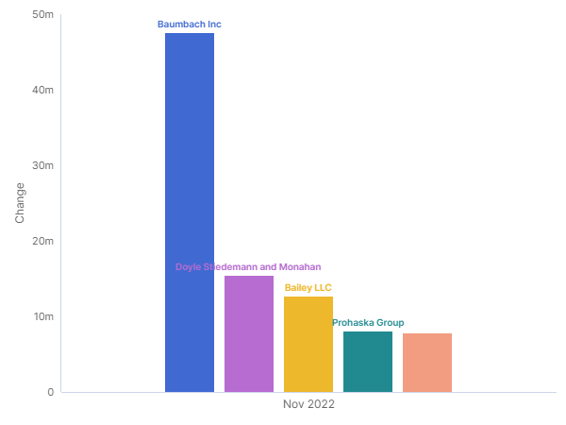
Impact of Customer Acquisition on Revenue
New or returning customers contributed to the overall increase in revenue
All five customers saw an increase in revenue
Baumbach Inc, Doyle Stiedemann and Monahan, Bailey LLC, Prohaska Group and Friesen-Roberts were the main contributors
Recommendation: Develop retention strategies to ensure these customers continue to contribute to revenue growth
Source: Alteryx Auto Insights
Notes:
This slide showcases the impact of customer acquisition on the revenue increase. It's evident that the new or returning customers played a significant role. Hence, we should focus on developing robust retention strategies to ensure they continue to contribute to our revenue growth.

Slide 5
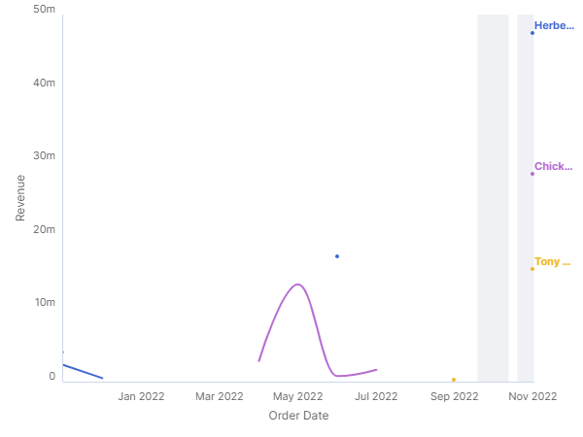
Role of Team Leads in Revenue Growth
New or returning Team Leads contributed significantly to the revenue increase
All three Team Leads saw an increase in revenue
Herbert Hugo, Chickie Kubin and Tony Dorkens were the main contributors
Recommendation: Encourage knowledge sharing and best practice exchange among Team Leads
Source: Alteryx Auto Insights
Notes:
This slide illustrates the crucial role of our Team Leads in the revenue growth. The new or returning Team Leads have made significant contributions. To further foster this growth, we should encourage knowledge sharing and best practice exchange among our Team Leads.

Slide 6
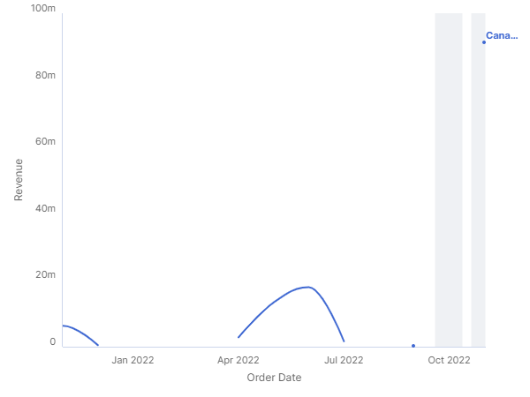
Country's Contribution to Revenue Growth
Canada contributed the most to the overall increase in revenue
Recommendation: Conduct a detailed market analysis in Canada to identify opportunities for further growth
Canada's return to the market saw a 100% increase in Revenue
Identify successful strategies in Canada and replicate them in other markets
Source: Alteryx Auto Insights
Notes:
This slide focuses on the contribution of Canada to the overall increase in revenue. A detailed market analysis in Canada could help identify opportunities for further growth. Moreover, the successful strategies identified in Canada should be replicated in other markets for similar success.

Slide 7

Regional Contribution to Revenue Growth
North America contributed the most to the overall increase in revenue
Recommendation: Conduct a detailed market analysis in North America to identify areas of opportunity
North America's return saw a 100% increase in Revenue
Identify successful strategies in North America and replicate them in other regions
Source: Alteryx Auto Insights
Notes:
This slide highlights the contribution of North America to the overall increase in revenue. A detailed market analysis in North America could reveal areas of opportunity. Additionally, the successful strategies identified in North America should be replicated in other regions for similar success.

Slide 8
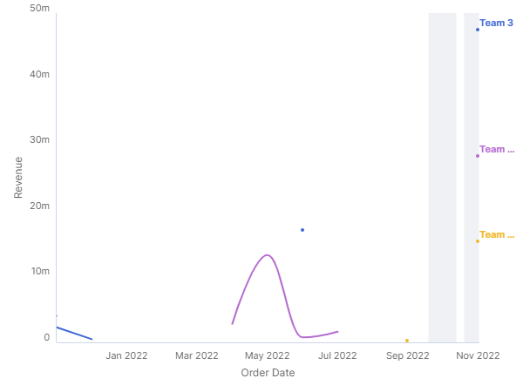
Team's Contribution to Revenue Growth
New or returning Teams contributed significantly to the revenue increase
All three Teams saw an increase in revenue
Teams 3, 12 and 11 were the main contributors
Recommendation: Encourage collaboration and knowledge sharing among teams
Source: Alteryx Auto Insights
Notes:
This slide shows the significant contribution of our teams to the revenue growth. The new or returning teams have made significant contributions. To further foster this growth, we should encourage collaboration and knowledge sharing among our teams.

